Slide 1
Lab22
איליה זלדנר

Slide 2
Memory-Mapped I/O
Instead of having special methods for accessing the values to be read or written, just get them from memory or put them into memory.
The device is connected directly to certain main memory locations.
Two types of information to/from the device
Status
Value read/write

Slide 3
Why use Memory Mapped I/O
Advantages of memory-mapped I/O:
An I/O device driver can be written entirely in C
No special protection mechanism is needed to keep user process from performing I/O.
Every instruction that can reference memory can also reference control register.
Disadvantages of memory-mapped I/O:
Caching a device control register would be disastrous (not reflect current device status change).
All memory modules and all I/O devices must examine all memory references.

Slide 4
The device controller has “registers”.
These registers are given a memory address.
Recall that the processor is attached to a bus, memory is attached to the bus, I/O devices are attached to the bus.
When the bus sees certain addresses, it knows they are not memory addresses, but are addresses for accessing I/O devices.

Slide 5
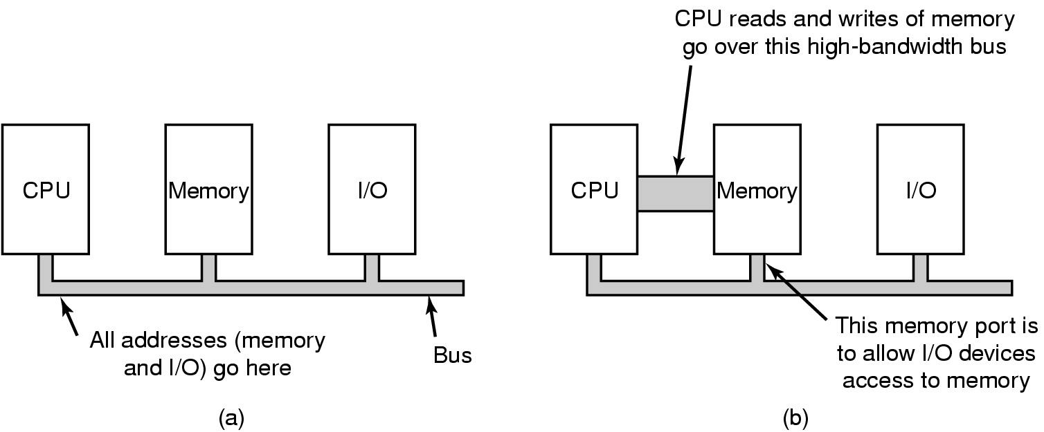
(a) A single-bus architecture
(b) A dual-bus memory architecture

Slide 6
Interactions in a Graphics System
An O/S (DOS, Windows, etc.) and/or Application program (word processor, game, etc.) updates information on the screen using the Video BIOS or a Video Device Driver.
An installable Device Driver is a program that works with the O/S to translate commands that control a piece of hardware, typically for extended functions not supported by standard hardware.
Operating System
Applications
SOFTWARE
BIOS / Graphics Drivers
Software Interrupt 10h is used for Video BIOS routines
Graphics
Subsystem
Microprocessor
Video Controller
DISPLAY
HARDWARE
PC RAM / ROM
Video
Memory
DAC

Slide 7
Video Data Format Overview
Video Display Modes: Video subsystems operate in multiple display modes which control certain aspects of the video operation.
Text OR Graphics:
Text modes display alphanumeric characters only.
Graphics modes are bit-mapped (All Points Addressable)

Slide 8
The information written to the video buffer by the microprocessor is represented on the screen as a pattern of illuminated dots called pixels.
The microprocessor writes information to the video hardware’s display buffer in either alphanumeric or graphics format.
Each location on the video screen maps to a location in the display RAM.
The first location of the display buffer maps to the top, leftmost point on the screen.
As memory addresses increase, the screen location move from left to right & top to bottom.

Slide 9
Alphanumeric format: (Text Mode)
The microprocessor writes each symbol (letter, number, etc) as a series of 2 bytes (character & attribute) into the Video Memory.
The first byte represents the character’s ASCII value
The second byte represents the character’s attribute (i.e. color, foreground/background, blinking, intensity)
Video hardware translates the character & attribute bytes to the necessary series of dots.
Characters are painted on the screen in a matrix of dots called a character box or character cell.

Slide 10
Alphanumeric format
(Text Mode)
Seg:Offset
41h
B800:0 ASCII
07h
B800:1 Attrib.
42h
B800:2
07h
B800:3
43h
B800:4
07h
B800:5
B800:6
A
B
C
B800:7
SCREEN
Mapping from the display
memory to the screen.
Segment B800 - Text Mode

Slide 11
PORTS
VGA uses two ports for controlling the cursor position.
Port 3D5H is the PC Color Graphics 6845 Video CRT Control Register.
Writing to this port controls position of the cursor.
A cursor high and a cursor low position need to be written to port 3D5H.
Port 3D4H (Index register) is used to specify whether the low or high position is being written to port 3D5.

Slide 12
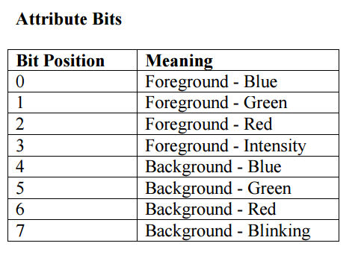
Writing a 0x0F to the Index register (3D4) selects the cursor low position.
A subsequent write to port 3D5 will set the cursor low position.
Writing a 0x0E to the Index register selects the cursor high position. A subsequent write to port 3D5 will set the cursor high position.

Slide 13
